Slide 1
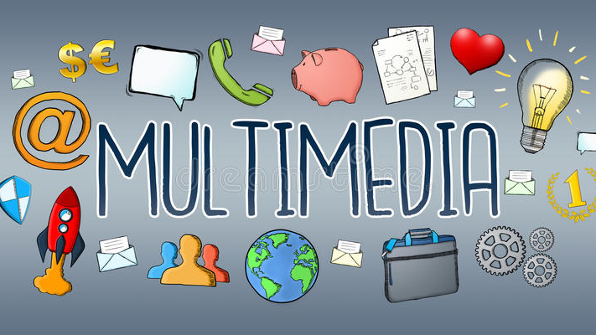

Slide 2
Introduction
Multimedia is a form of communication that uses the combination of different contents form such as text, audio, images, animations or video into a single interactive presentation.
Multimedia can be recorded for playback on computers, laptops, smartphones and other electronic devices.
Some examples of multimedia includes video podcast, audio slideshows and animated videos.

Slide 3
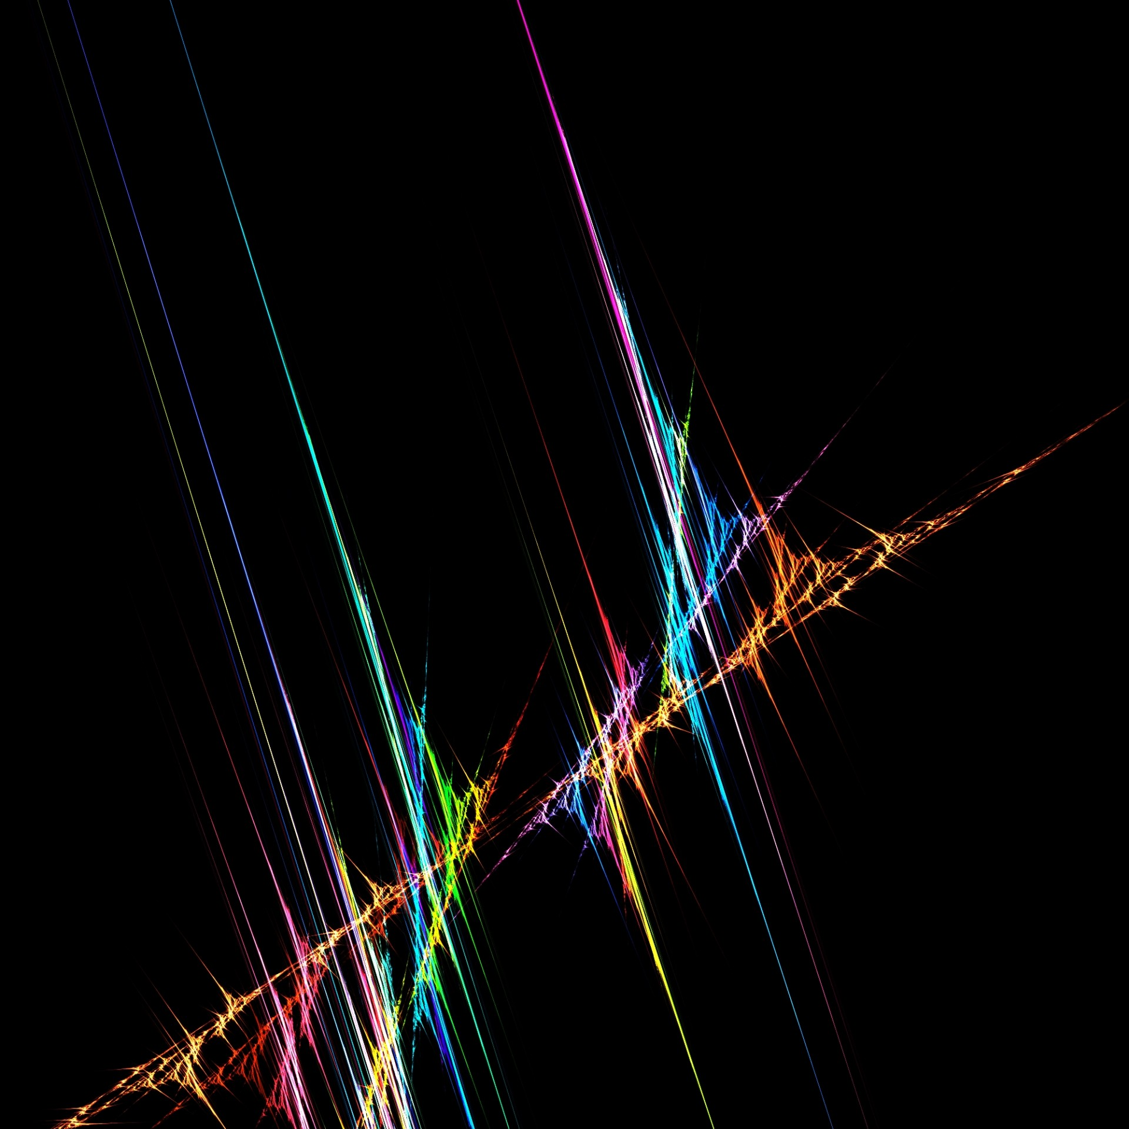
Components of Multimedia
1) Text:
Text is the most common medium of representing the information. In multimedia, text is mostly use for titles, headlines , menu etc. The most commonly used software for viewing text files are Microsoft Word, Notepad, Word pad etc. Mostly the text files are formatted with ,DOC, TXT etc extension.
2)Audio:
In multimedia audio means related with recording, playing etc. Audio is an important components of multimedia because this component increase the understandability and improves the clarity of the concept. Audio includes speech, music etc. The commonly used software for playing audio files are: i) Quick Time ii) Real player iii) Windows Media Player

Slide 4
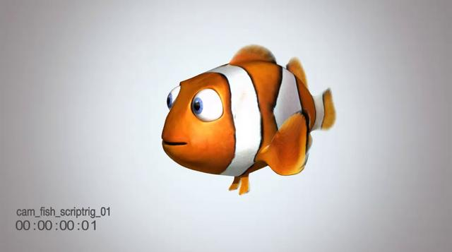
3) Graphics:
Every multimedia presentation is based on graphics. The use of graphics in multimedia makes the concept more effective and presentable. The commonly used software for viewing graphics are windows Picture, Internet Explorer etc. The commonly used graphics editing software is Adobe Photoshop through which graphics can be edited easily and can be make effective and attractive.
4) Video:
Video means moving pictures with sound. It is the best way to communicate with each other. In multimedia it is used to makes the information more presentable and it saves a large amount of time. The commonly used software for viewing videos are: i) Quick Time ii) Window Media Player iii) Real Player
5)Animation:
In computer animation is used to make changes to the images so that the sequence of the images appears to be moving pictures. An animated sequence shows a number of frames per second to produce an effect of motion in the user's eye. Some of the commonly used software for viewing animation are: i) Internet Explorer ii) Windows Pictures iii) Fax Viewer

Slide 5
Application Area of multimedia
1) Entertainment and Fine Arts:
Multimedia is heavily used in the entertainment industry, especially to develop special effects in movies and animations. Multimedia games are a popular pastime and are software programs available either as CD-ROMs or online. Some video games also use multimedia features.
2) Education:
In Education, multimedia is used to produce computer based training courses (popularly called CBTs) and reference books like encyclopedia. Edutainment is an informal term used to describe combining education with entertainment, especially multimedia entertainment. The idea of media convergence is also becoming a major factor in education, particularly higher education.

Slide 6
Characteristics of Multimedia
Multimedia systems must be computer controlled.
Multimedia systems are integrated
The information they handle must be represented digitally
The interface to the final presentation of media is usually interactive

Slide 7
3) Mathematical and Scientific Research:
In Mathematical and Scientific Research, multimedia is mainly used for modeling and simulation.
4) Medicine:
In Medicine, doctors can get trained by looking at a virtual surgery. They can simulate how the human body is affected by diseases spread by viruses and bacteria and then develop techniques to prevent it.

Slide 8
Image File Format
Vector vs. Raster
Raster Image Files
Raster images are constructed by a series of pixels, or individual blocks, to form an image. JPEG, GIF, and PNG are all raster image extensions. Every photo you find online or in print is a raster image. Pixels have a defined proportion based on their resolution (high or low), and when the pixels are stretched to fill space they were not originally intended to fit, they become distorted, resulting in blurry or unclear images.

Slide 9
Vector Image Files
Vector images are far more flexible. They are constructed using proportional formulas rather than pixels. EPS, AI and PDF are perfect for creataing graphics that require frequent resizing. Your logo and brand graphics should have been created as a vector, and you should always have a master file on hand. The real beauty of vectors lies in their ability to be sized as small as a postage stamp, or large enough to fit on an 18-wheeler!

Slide 10
Image File Format
1. JPEG (or JPG) - Joint Photographic Experts Group
JPEGs might be the most common file type you run across on the web, and more than likely the kind of image that is in your company's MS Word version of its letterhead. JPEGs are known for their "lossy" compression, meaning that the quality of the image decreases as the file size decreases.
2. PNG - Portable Network Graphics
PNGs are amazing for interactive documents such as web pages but are not suitable for print. While PNGs are "lossless," meaning you can edit them and not lose quality, they are still low resolution.

Slide 11
Image File Format
3. GIF - Graphics Interchange Format
GIFs are most common in their animated form, which are all the rage on Tumblr pages and in banner ads. It seems like every day we see pop culture GIF references from Giphy in the comments of social media posts. In their more basic form, GIFs are formed from up to 256 colors in the RGB colorspace. Due to the limited number of colors, the file size is drastically reduced.
4. TIFF - Tagged Image File
A TIF is a large raster file that doesn't lose quality. This file type is known for using "lossless compression," meaning the original image data is maintained regardless of how often you might copy, re-save, or compress the original file.

Slide 12
Image File Format
5. PSD - Photoshop Document
PSDs are files that are created and saved in Adobe Photoshop, the most popular graphics editing software ever. This type of file contains "layers" that make modifying the image much easier to handle. This is also the program that generates the raster file types mentioned above.
6. PDF - Portable Document Format
PDFs were invented by Adobe with the goal of capturing and reviewing rich information from any application, on any computer, with anyone, anywhere. I'd say they've been pretty successful so far.

Slide 13
Multimedia in Business
Advertising: Multimedia is used in advertising to grab the attention of potential customers. Advertisements with video or animations tend to be more engaging and memorable than static images or text. Multimedia ads can be used on various platforms such as television, social media, and websites.
Training and education: Multimedia is used for training and educating employees. Training videos, interactive courses, and simulations are examples of multimedia used in training. Multimedia can also be used to deliver educational content to customers such as tutorials, webinars, and e-learning courses.
Presentations: Multimedia is used in presentations to convey complex ideas in a more engaging and understandable way. Presentations with multimedia elements are more visually appealing and tend to be more memorable than text-heavy presentations.

Slide 14
Multimedia in Business
Product demonstrations: Multimedia is used to showcase products in a more interactive and engaging way. Product demos with multimedia elements such as videos, animations, and 3D models can give customers a better understanding of the product's features and benefits.
Communication: Multimedia is used in business communication to enhance the effectiveness of the message. Multimedia elements such as images and videos can help to convey emotions and tone, making the message more impactful and persuasive.
In conclusion, the use of multimedia in business has become essential in today's digital age. Multimedia can help businesses to communicate more effectively, engage customers, and enhance the overall user experience.

Slide 15
Web Based Multimedia
Web-based multimedia refers to the use of multimedia elements such as text, images, audio, and video on the internet. With the increasing popularity of the internet, web-based multimedia has become a critical aspect of online communication and marketing. Here are some examples of web-based multimedia:
Websites: Websites are the most common example of web-based multimedia. Websites can contain text, images, audio, and video elements, and can be designed in a way that is interactive and engaging.
Social media: Social media platforms such as Facebook, Twitter, and Instagram are examples of web-based multimedia. These platforms allow users to share text, images, and videos with their followers, making it an effective way to communicate with a broader audience.

Slide 16
Web Based Multimedia
Online advertising: Web-based multimedia is widely used in online advertising. Advertisements with multimedia elements such as video or animations tend to be more engaging and memorable than static images or text.
Online streaming: Online streaming services such as Netflix and YouTube are examples of web-based multimedia. These services allow users to watch videos, TV shows, and movies online.
Webinars: Webinars are web-based multimedia presentations used for educational and marketing purposes. Webinars can be interactive and engaging, allowing attendees to ask questions and participate in discussions.

